Slide 1
Preparation Group’s Work 17-10-2022
To make the group assignment more efficient, please make sure you are prepared by completing the following steps:
For exercise 1:
Make sure you watched both interviews in Chapter 5 (SSR Mainports Rotterdam: https://youtu.be/CG73Z2zxx4U and Smart City The Hague: https://youtu.be/lJnLQse3ZoE).
For exercise 2:
Look at the indicators mentioned in Chapter 1 of the reader;
Look at the indicators mentioned in Chapter 7 (see the videos or the attached literature, or both).
For exercise 3:
Make sure you are familiar with the scheme (mentioned in Chapter 7, both literature and videos), we will use this one to work with;
We will analyse the case of Smart City The Hague. Therefore, make sure you watched and understand the video (see the link above).

Slide 2

17-10-2022
Chairman: Stijn
Taking notes: Roan
Uploading: Tim

Slide 3
Schedule group’s work 17-10-2022
15:40-15:45
Settle in
15:45-16:05
Exercise 1: Identify the values of the stakeholders in the cases of Smart City The Hague and SSR Mainport Rotterdam (Ch. 5)
16:05-16:10
Break
16:10-16:25
16:25-17:00
Exercise 3: Analyse Smart City The Hague (Ch. 5) according the scheme from Werker, 2020
Exercise 2: Analyse, compare and discuss the advantages and disadvantages of the indicators from Ch. 1 and Ch. 7

Slide 4
Exercise 1: Values Stakeholders
What are the values that play a role fore the stakeholders in the cases of Ch. 5?
What are the differences and similarities?
 | Smart City The Hague | SSR Mainport Rotterdam
1
2
3
4
5
6
7

Slide 5
Exercise 2: Indicators Ch.1 & Ch.2
Discuss & Compare;
Look into the advantages & disadvantages;
What are the similarities and differences.
 | Indicator Ch. 1 | Indicators Ch. 7
1
2
3
4
5
6
7

Slide 6

BREAK
16:05-16:10

Slide 7
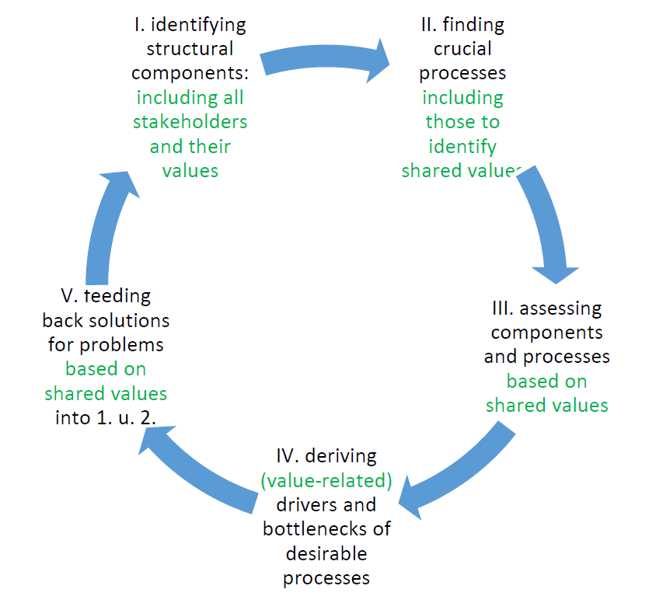
Exercise 3: Analysing with a Scheme
I. identify the structural components including all innovative agents and/or stakeholders
and their values (use results from Ex. 1 of Chapter 6)
II. find crucial processes including those to identify shared values
III. assess components and processes based on shared values (if you can detect them, else provide some insights how they could look like)
IV. derive (value-related) drivers and bottlenecks ofdesirable processes
V. propose solutions for problems based on shared values

Slide 8
Exercise 3: Results (Summary)
PLEASE SUMMARIZE THE RESULTS HERE

